Slide 1

Code Refactoring and Bug Fixing

Slide 2
Scenario:
A team of enthusiastic data scientists embarked on a mission to develop a Note Taking
application using Python, Flask, and HTML. However, their lack of experience in backend
development has led to challenges in making the application fully functional. Recognizing your
proficiency in backend development, you have been tasked with fixing the broken code
and ensuring the application works seamlessly.
Task
Refactor the existing codebase and ensure the proper functioning of the Note Taking Application. Document all identified bugs during the debugging process. Remember, the task is not about recreating the app from scratch. Your goal is to fix the already existing codebase and make the application work as intended.

Slide 3
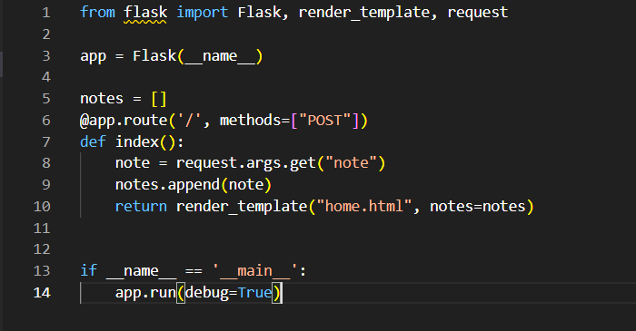
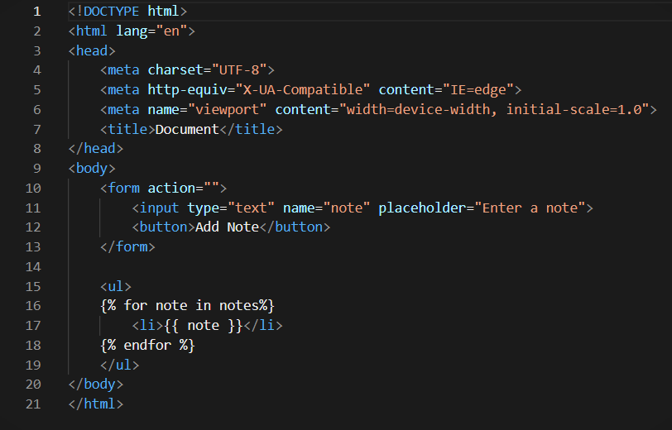
Identifying and Resolving the Bugs in the Initial Code
The following code snippets represents the initial state of
Flask Application.
The figure 1 and 2 contains identifiable Bugs , which is
Impacting the functionality.
Therefore we need to make the necessary changes to execute
It.

Slide 4
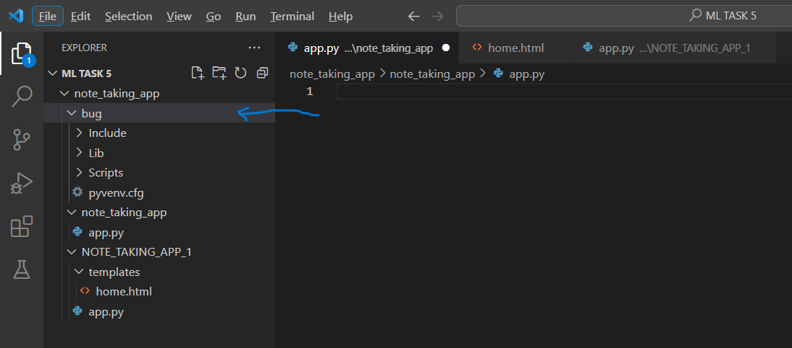
Steps for Code Refactoring and Bug fixing :
Creating a Virtual Environment :

Slide 5
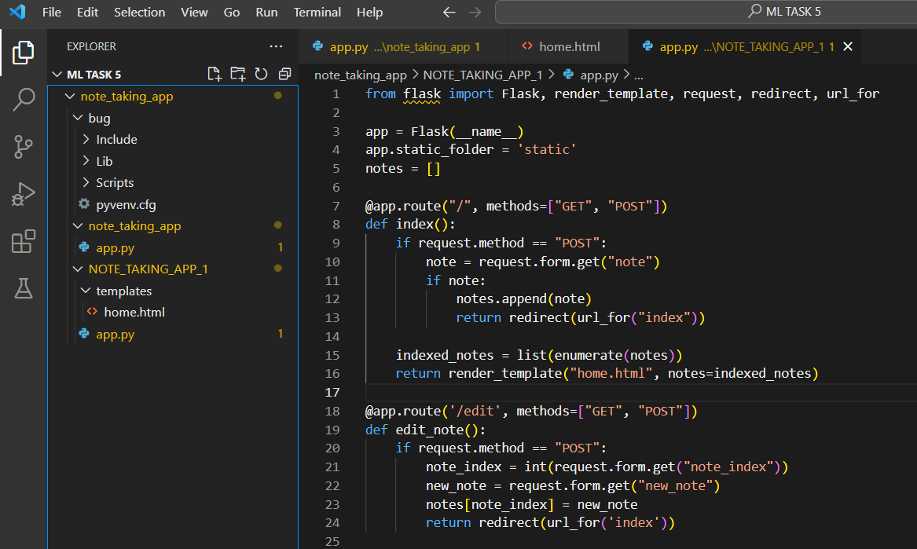
Identifying and correcting Bugs in the python code
NOTE :
This is just a sample code ,
You can find full python
Code In my GitHub.

Slide 6
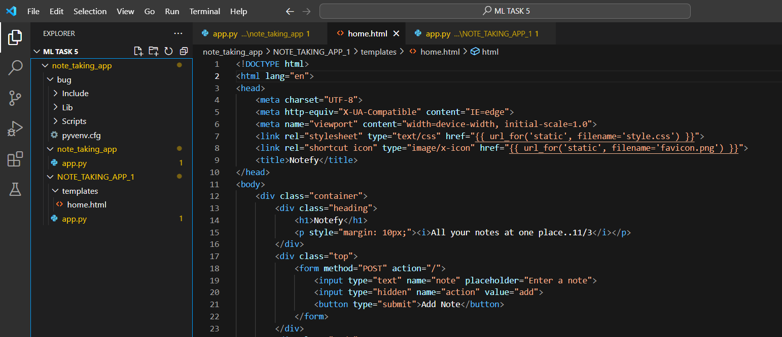
Identifying and correcting the Bugs in the HTML Code :

Slide 7
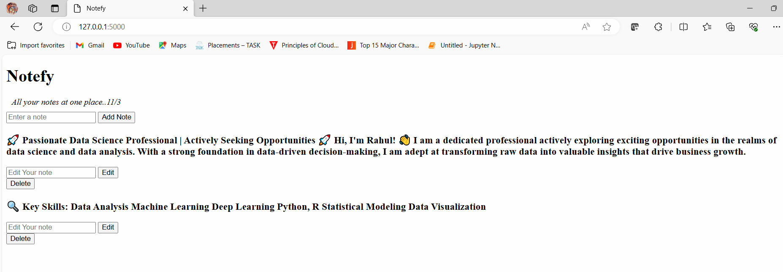
Output :

Slide 8

THANK YOU

